Slide 1















GitHub Actions
Name: Anirudh Sharma
Roll No: MT2025732
Team: Team-4

Slide 2
What is GitHub Actions?
Event-Driven Automation
“Automate everything in your repositories!”
Why: Automate work and enforce consistency
Test and Build
Package and Deploy
Schedule
Integrate
Event
Workflow
Jobs
Steps
Runner

Slide 3
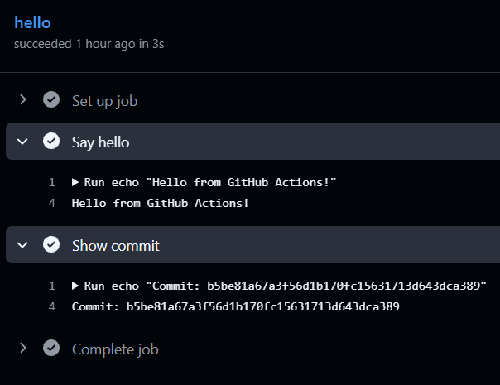
Example 1 - Simple Echo
name: Demo
on:
push:
jobs:
hello:
runs-on: ubuntu-latest
steps:
- name: Say hello
run: |
echo "Hello from GitHub Actions!"
- name: Show commit
run: |
echo "Commit: ${{ github.sha }}"

Slide 4
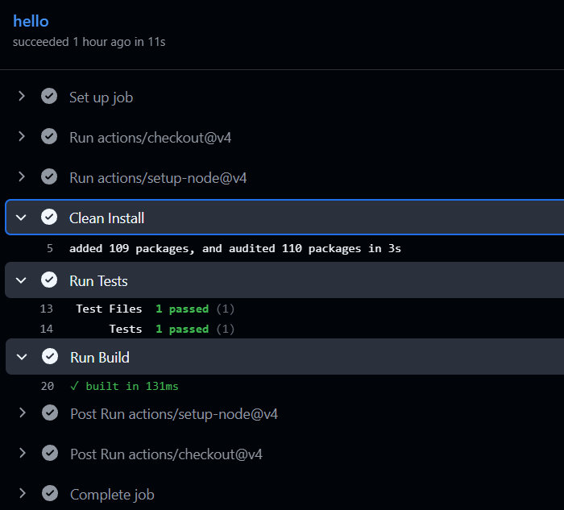
Example 2 - Run tests and build
name: Continuous Integration
on:
push:
jobs:
hello:
runs-on: ubuntu-latest
steps:
- uses: actions/checkout@v4
- uses: actions/setup-node@v4
with:
node-version: 22
- name: Clean Install
run: npm ci
- name: Run Tests
run: npm test
- name: Run Build
run: npm run build

Slide 5
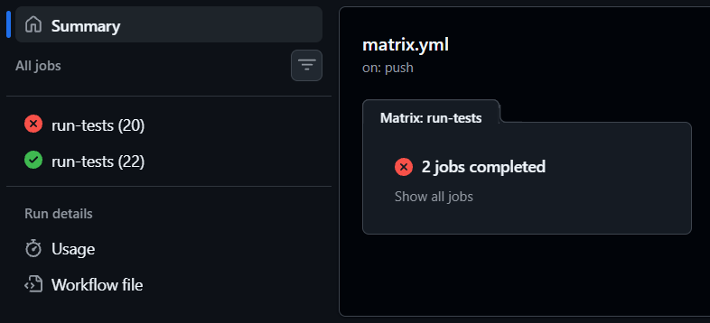
Example 3 - Matrix Execution
name: Matrix Configuration
on:
push:
jobs:
run-tests:
strategy:
matrix:
node: [20, 22]
runs-on: ubuntu-latest
steps:
- uses: actions/checkout@v4
- uses: actions/setup-node@v4
with:
node-version: ${{ matrix.node }}
- name: Clean Install
run: npm ci
- name: Run Tests
run: npm test -- --run

Slide 6
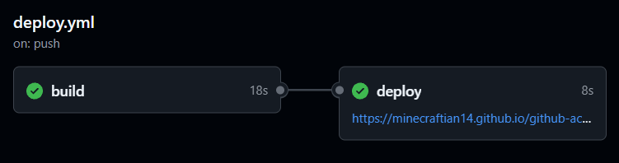
Example 4 - Continuous Deployment
name: Build and Deploy
on:
push:
branches: [main]
workflow_dispatch:
permissions:
contents: read
pages: write
id-token: write
concurrency:
group: "pages"
cancel-in-progress: true
jobs:
build:
runs-on: ubuntu-latest
steps:
- uses: actions/checkout@v4
- uses: actions/setup-node@v4
with:
node-version: 22
cache: npm
- run: npm ci
- run: npm test -- --run
- run: npm run build
- uses: actions/configure-pages@v5
- uses: actions/upload-pages-artifact@v3
with:
path: ./dist
deploy:
needs: build
runs-on: ubuntu-latest
environment:
name: github-pages
url: ${{ steps.deployment.outputs.page_url }}
steps:
- id: deployment
uses: actions/deploy-pages@v4

Slide 7
Scheduling Jobs using Cron Expressions
on:
schedule:
- cron: '0 8 * * 1-5'
workflow_dispatch:
jobs:
run-task:
runs-on: ubuntu-latest
steps:
- name: Run Script
run: |
echo "Hello World!"
echo "Triggered by ${{ github.event_name }}"
Automation without Events
“Automation that runs without a code change”
Run workflows on a schedule
Also supports manual runs with workflow_dispatch
Useful for:
Nightly Checks
Generating Reports
Maintenance

Slide 8
Advanced Production Features
Secrets
Credentials & sensitive configuration
Environments
Staging / production + approvals
Artifacts
Build outputs shared between jobs
Caching
Faster dependency and build workflows
Reusable workflows
Standardize automation across repositories
Self-hosted runners
Run jobs on your own infrastructure

Slide 9
Thank You
Name: Anirudh Sharma
Roll No: MT2025732
Team: Team-4

